Slide 1
Spatial Transcriptomics
9 April 2025

Slide 2
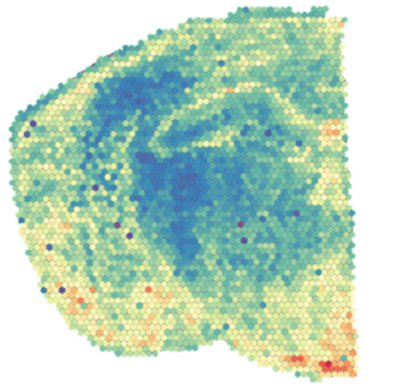
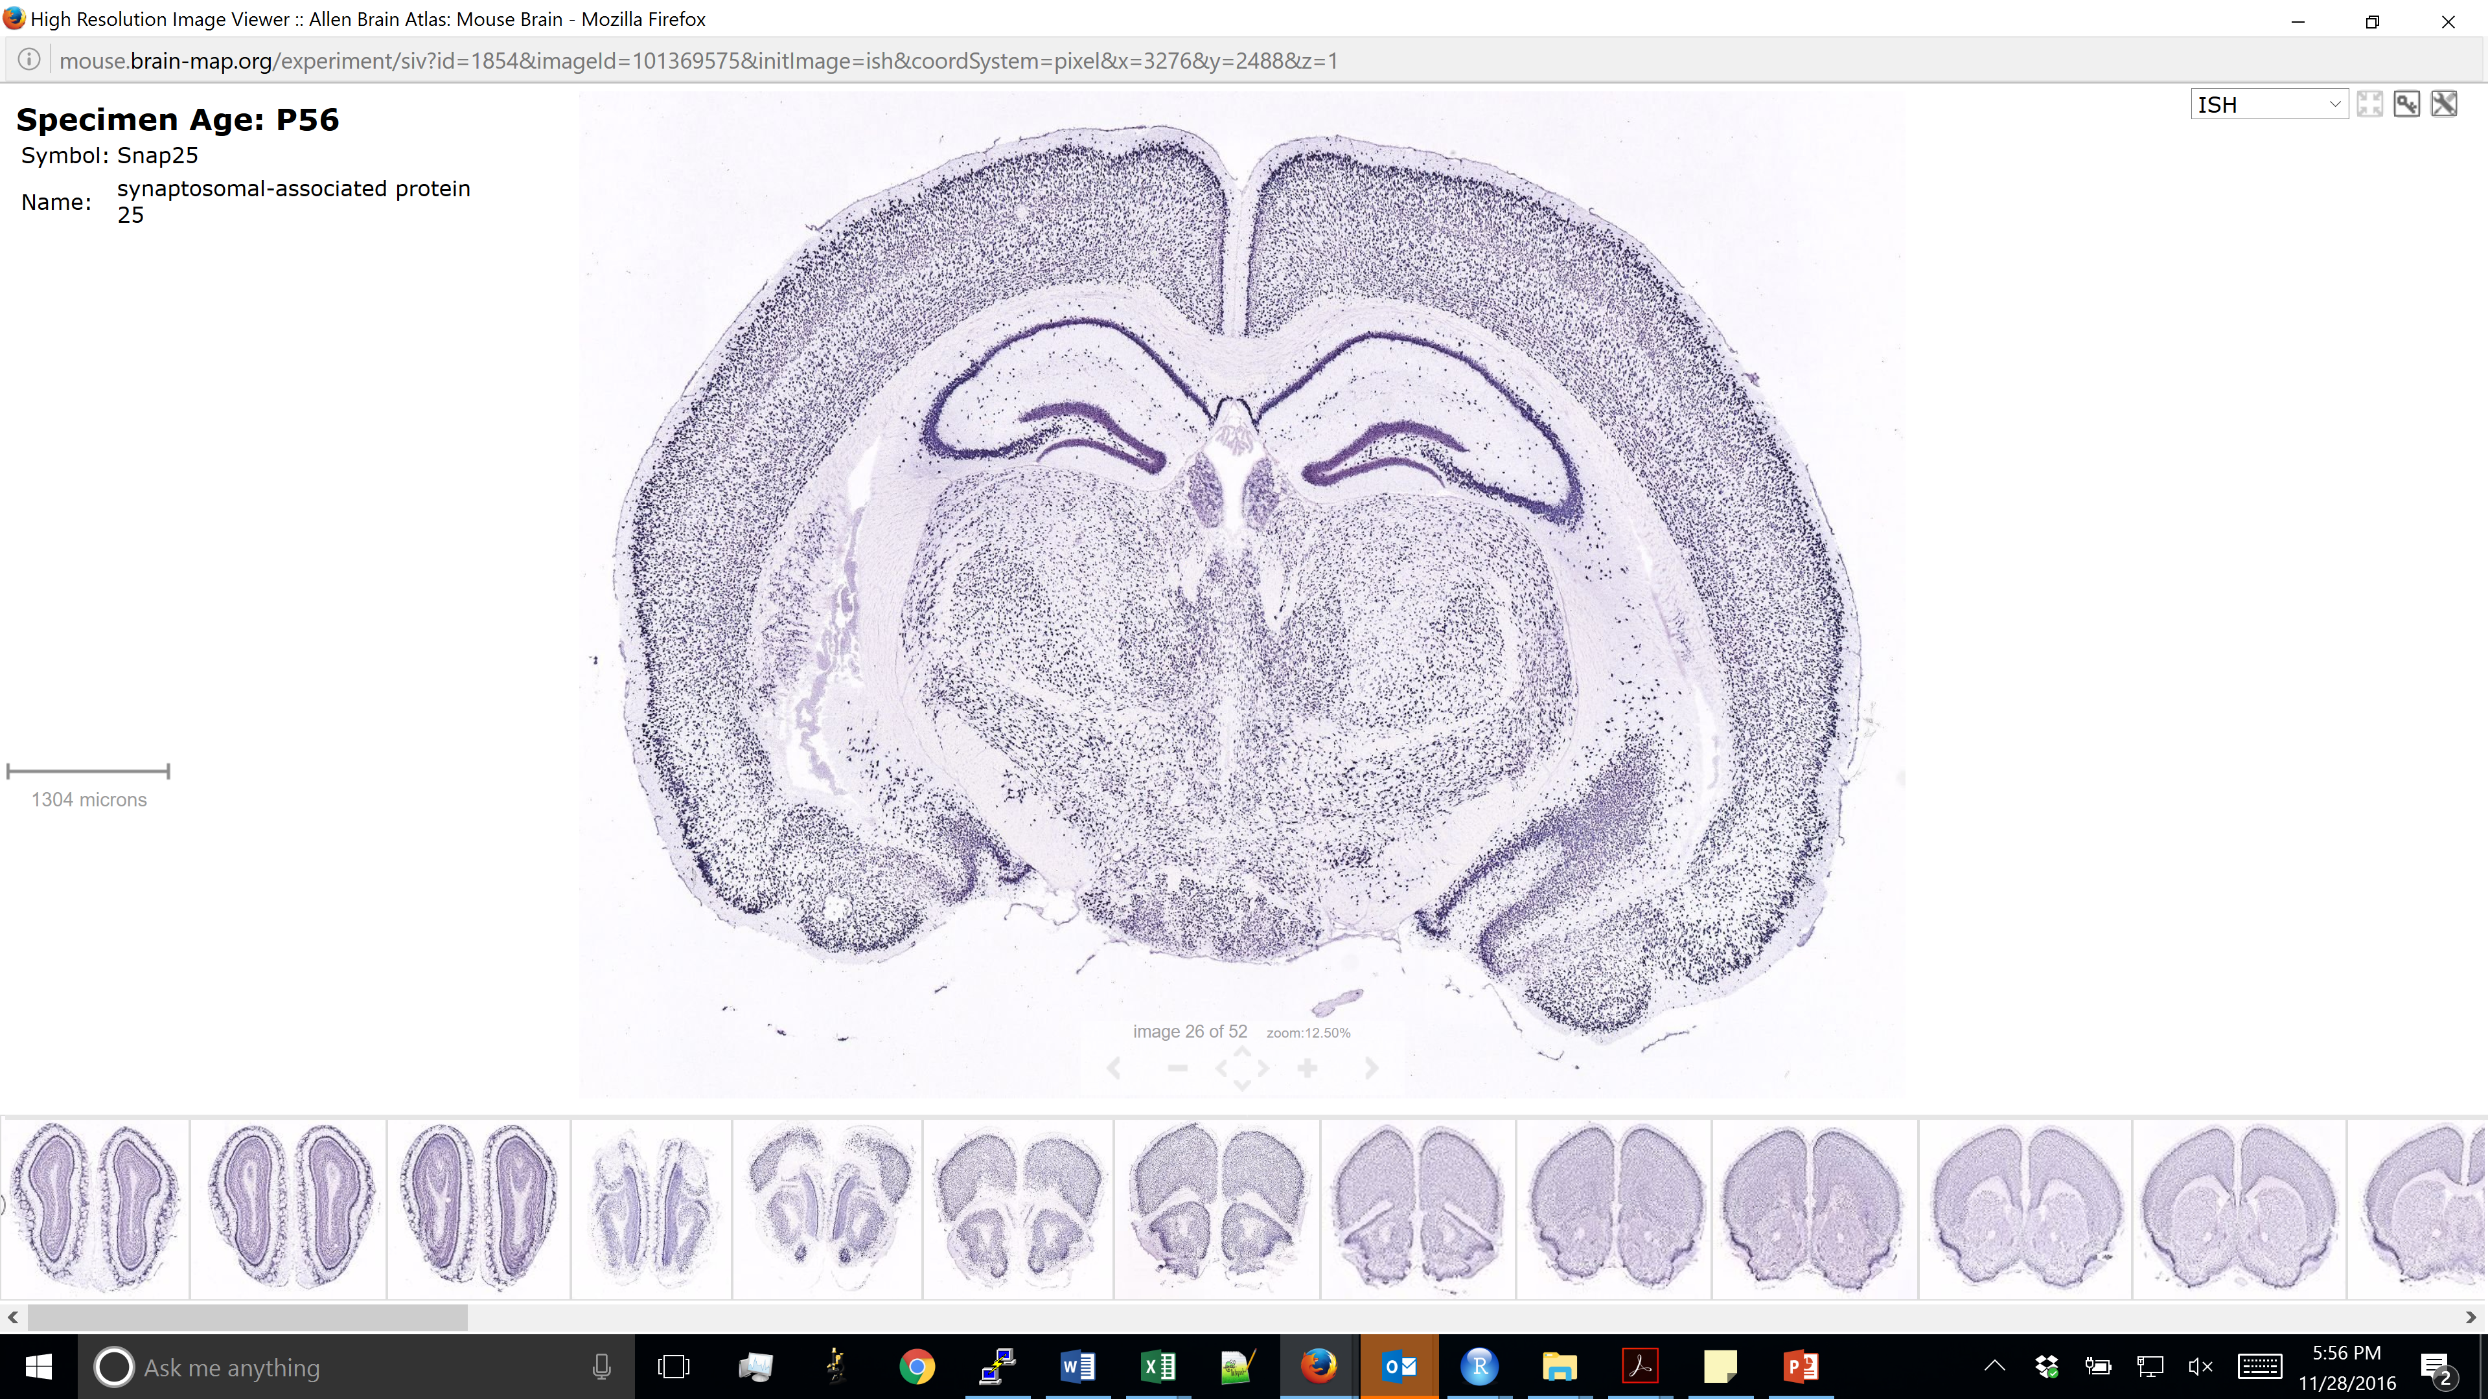
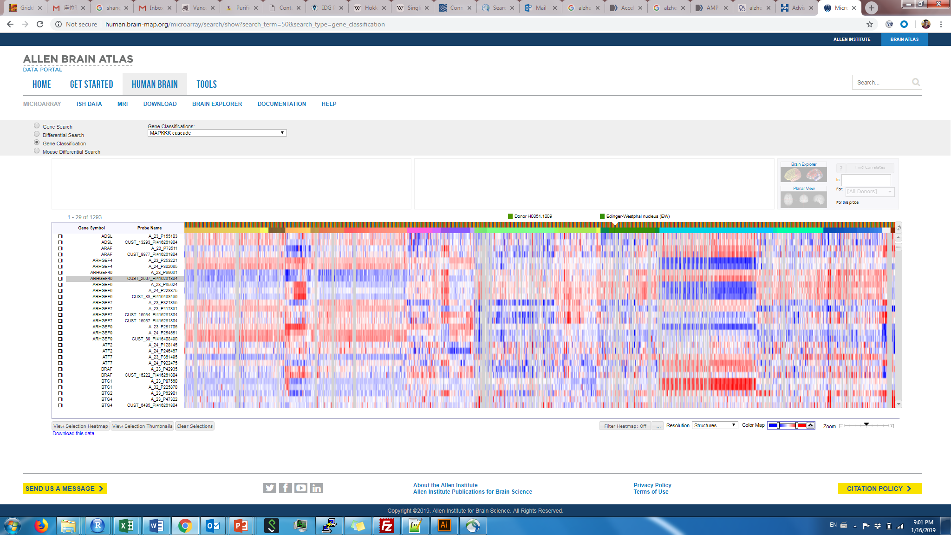
Molecular profiling methods
Method | ISH/IHC | RNA-sequencing
# of genes/proteins at once | ~1 – 5 (~500 with advanced methods) | ~10,000 – 20,000
Single-cell resolution | Yes | No
Spatial information | Yes | No
“Unbiased” (no pre-selection) | No | Yes
Single-cell RNA-seq
~1,000 – 10,000
Yes
No
Yes
Spatial transcriptomics
~1,000 – 10,000
Possible
Yes
Possible

Slide 3
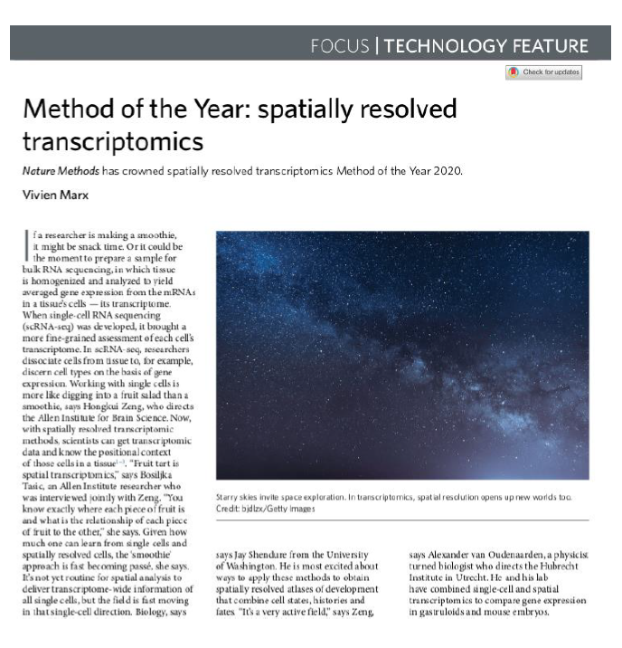
Background
Rapid advancement of ST technologies in the past 5 years
Combines transcriptomics with imaging
Can achieve sub-cellular resolution
Analysis methods need to account for spatial information and sensitivity

Slide 4
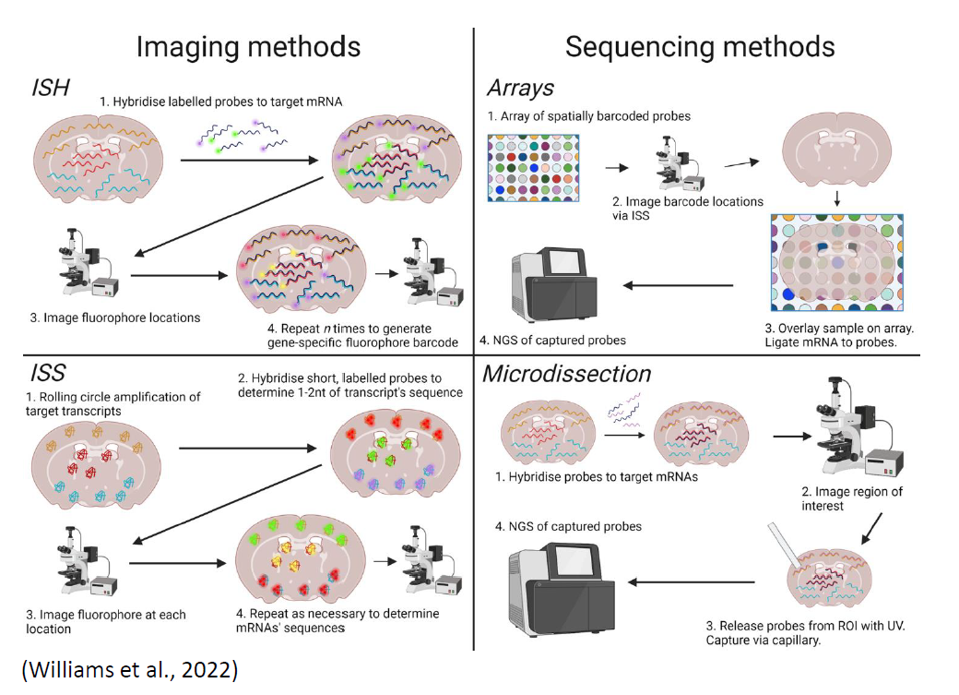
Types of ST platforms
Considerations when selecting an ST platform:
Targeted vs. untargeted (transcriptome-wide)
Compatibility with IHC
Spatial resolution
Throughput

Slide 5
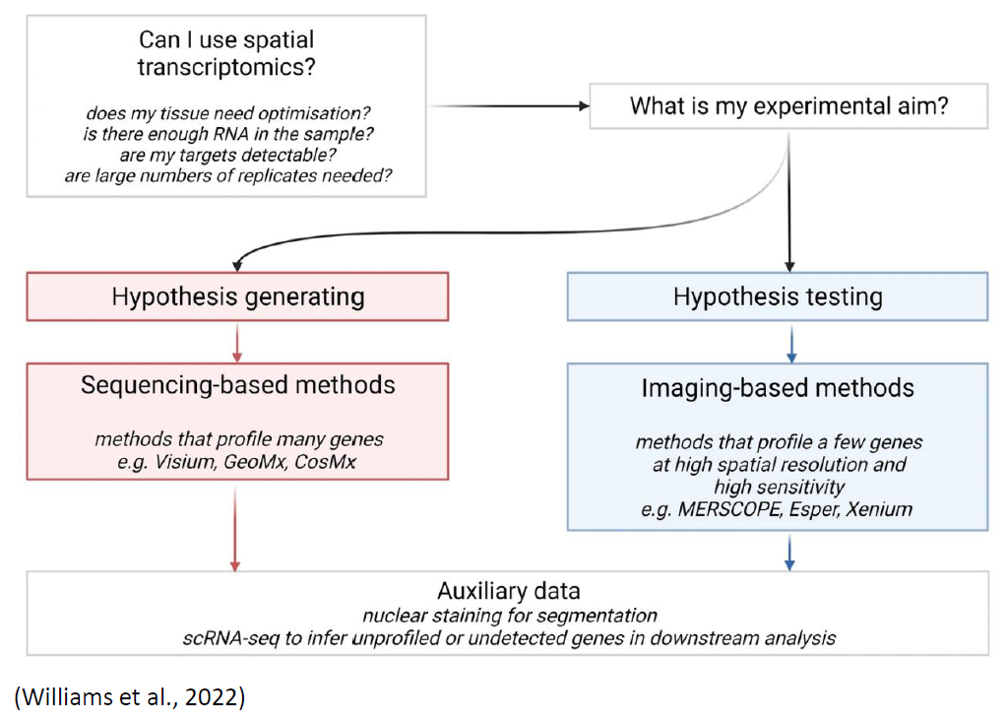
How to choose an appropriate platform

Slide 6
Summary of some available platforms
Platform | Developer | Class | Resolution | # of genes | IHC
GeoMx | Nanostring | Imaging based | 10-20 cells | 1k-18k | Compatible
CosMX | Nanostring | Imaging based | Subcellular | 1k | Integrated (up to 64)
Visium | 10x Genomics | Sequencing based | 55 micron diameter, 110 micron spot-to-spot distance | Transcriptome-wide (often ~5k per spot) | Compatible, but staining first
VisiumHD | 10x Genomics | Sequencing based | 2x2 micron, often aggregated to 8x8 or 16x16 | Transcriptome-wide | Compatible, but staining first
Xenium | 10x Genomics | Imaging based | Subcellular | 480 custom, 5k pre-selected | Compatible, but staining afterwards
MERSCOPE | Vizgen | Imaging based | Subcellular | Up to 1k custom | Compatible, but staining afterwards
Stereo-seq | STOmics | Sequencing based | 0.2x0.2 micron, often aggregated to 25x25 | Transcriptome-wide | Compatible, but staining first
Slide-seq | Curio | Sequencing based | Single nucleus | Transcriptome-wide | Not compatible

Slide 7
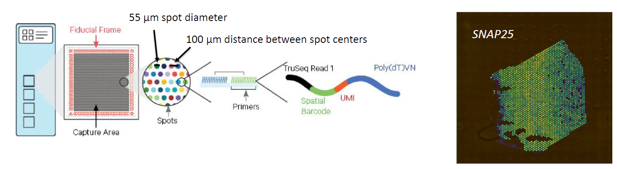
Sequencing-based platform: Visium
Note: VisumHD has 2-micron resolution, but is quite new

Slide 8
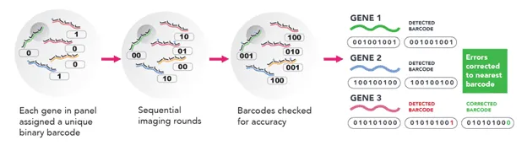
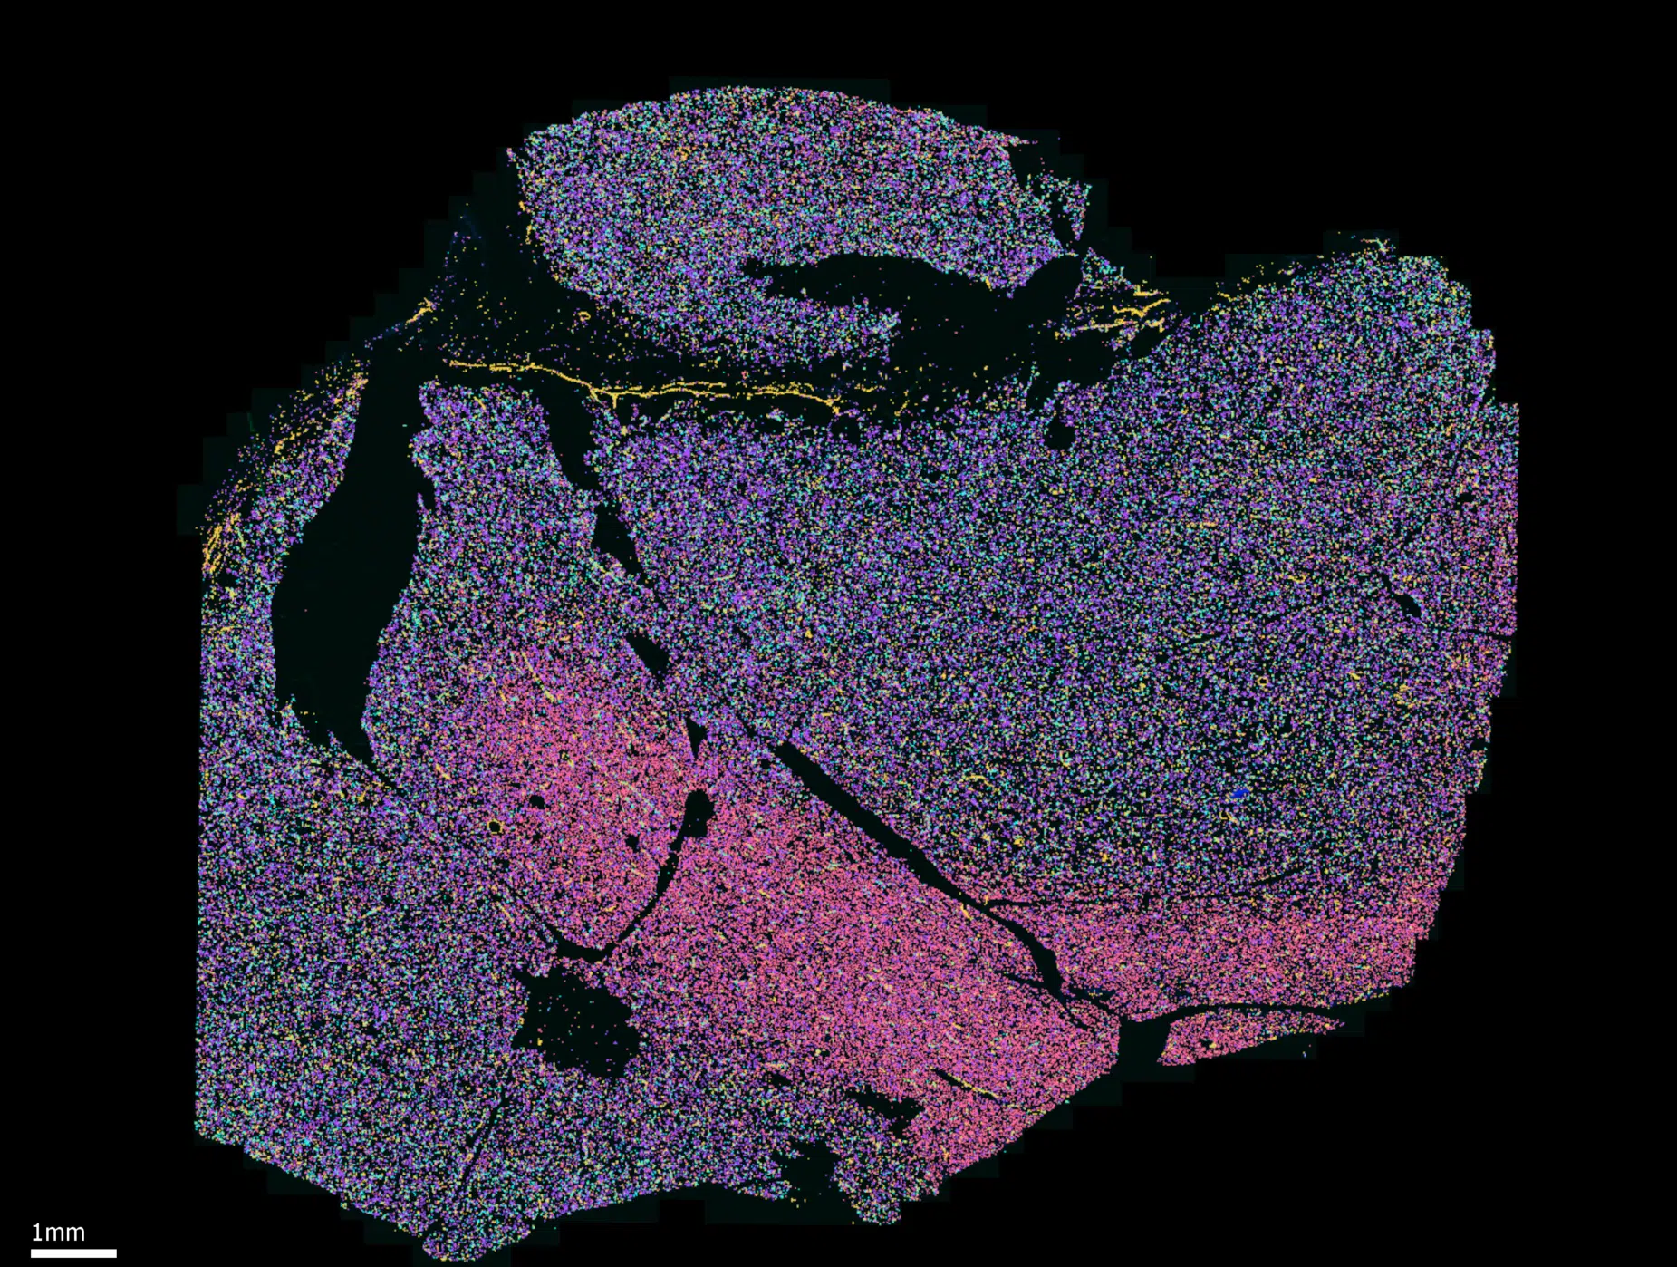
Imaging-based platform: MERSCOPE

Slide 9
Possible analysis questions/workflow
Pre-processing and quality control (platform-dependent)
Analysis 0 (optional for downstream analyses):Assignment of cell type identities
For single-cell resolution methods: transfer labels from reference (RCTD, Seurat, scanVI), or de novo clustering
For non-single-cell methods: spot/ROI deconvolution (Cell2Location, RCTD, etc.)
Analysis 1: Gene clustering
Identifying modes of gene expression with similar spatial patterns across regions and/or conditions (WGCNA, clustering methods)
Analysis 2: Spatial clustering
Identifying regions with similar gene expression/cell type composition patterns (BayesSpace, spaVE)
Analysis 3: Differential gene expression
Identifying differential genes within regions in the same section of tissue (Splotch, SpatialDE2)
Identifying differential genes within regions across multiple conditions (Splotch, Mixed-effect models with spatial priors)
Analysis 4: Spatially variable genes (SVGs)
Identifying genes with spatial patterning in the tissue (SPARK, SpatialDE2, MERINGUE)

Slide 10
QC & Normalization
 | Sequencing-based methods | Imaging-based methods
Initial QC | Similar to single-cell/single-nucleus RNA-seq: Number of Unique Molecular Identifiers (UMIs) per spot Number of genes detected per spot Library saturation/complexity Mitochondrial RNA can be used, but not as informative as in sc/snRNAseq | Nucleus/cell segmentation check (visual) Number of transcripts detected per cell Number of genes detected per cell
Normalization | Differential approaches use count data directly Clustering approaches use data scaled to total UMIs per spot | Can use data scaled to total transcripts per cell Alternatively, transcript number is normalized to cell/nucleus volume

Slide 11
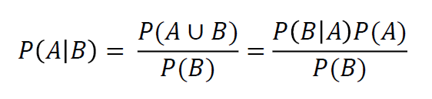
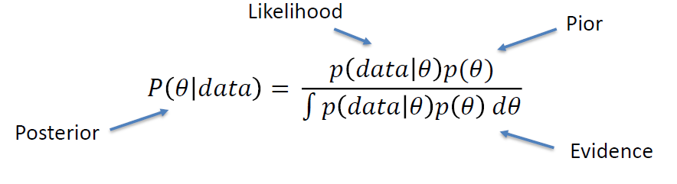
Refresher: Bayesian statistics
Key concept: incorporates prior information and observations to generate a posterior model
Bayes’ rule:
Probability(A, given B) = Probability(B, given A) x Probability(A) / Probability(B)
As a statistical inference model:
Prior

Slide 12
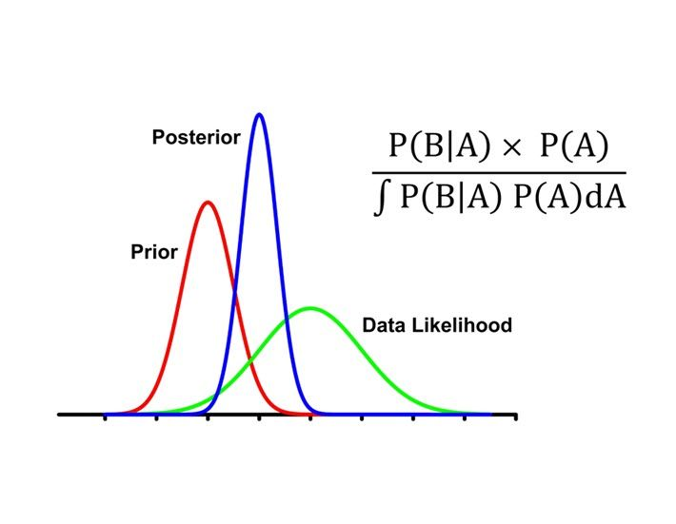
Bayesian statistics: concepts
Instead of a p-value (frequentist statistics), we usually report a Bayes factor
Bayes factor: Ratio of likelihoods of two models
BF = p(data | Model 1) / p(data | Model 0)
No hard limits/cutoffs on BF for “significance”, but BF>10 is an indicator of strong evidence for Model 1 over Model 0
VSNi

Slide 13
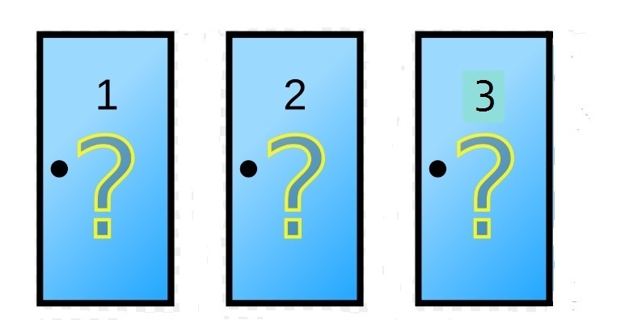


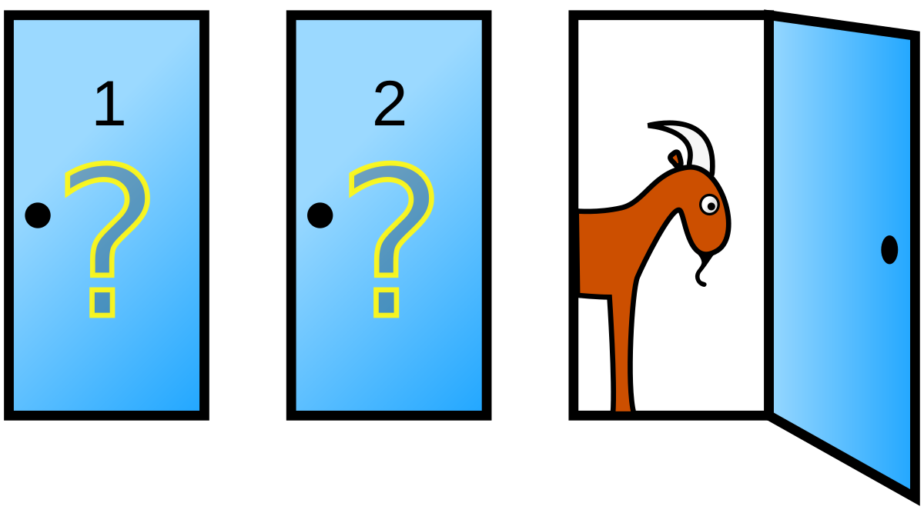
Example: Monty Hall Problem
You are presented with 3 identical doors. Behind one of them is a prize, and behind the other two are goats.
You select the door behind which (you think) the prize is.
USA Today
Monty opens one of the other doors to reveal a goat (always), and offers you the option to switch doors.
He will then open the door you selected to see if you won the prize.
Should you switch doors? Does it make a difference?

Slide 14
Group exercise: Monty Hall problem

